Slide 1
Predicting Viewer Sentiment with Deep Learning

Slide 2

Background
IMDB is an online database of information related to films, tv programs, and home videos.
IMDB has perhaps the largest repository for film and tv show reviews.
We can use the reviews and language processing to determine what made the films liked or not.
Furthermore, we can use data regarding what the user didn’t like or liked about the film to recommend positive films that have been reviewed where the things criticized are absent.

Slide 3

obtain
The reviews were sourced from a Kaggle database that had taken 50000 user reviews for films.
The database had the content of the review and an assessment on whether it was a positive review : (1) or a negative review : (0)

Slide 4

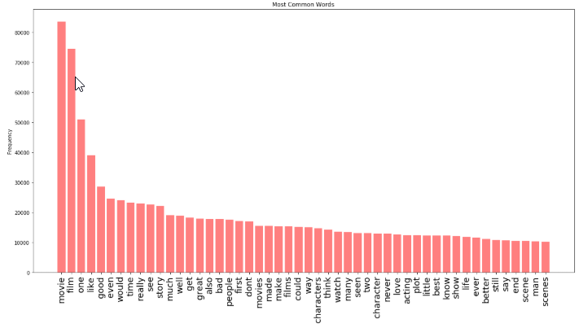
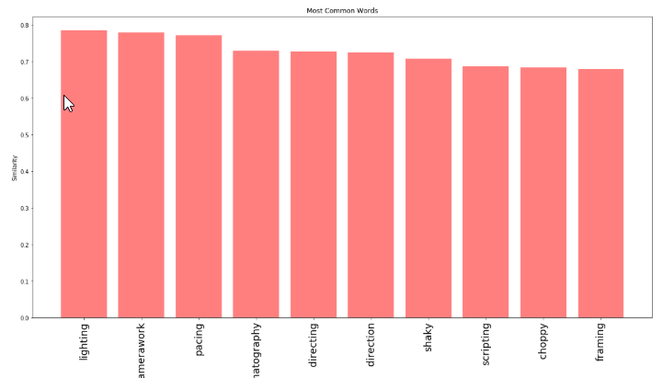
Explore
Here we see some of the most commonly used words within the dataset.
Word2Vec shows us the presence of word similarity in the dataset.

Slide 5
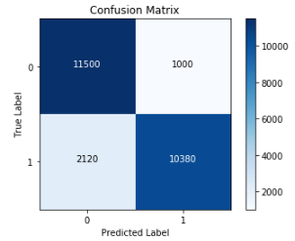
Modeling
Our most optimal parameters were having a model with 1 epoch and a batch size of 128.
Correctly predicts 87 percent of all film reviews.

